Slide 1



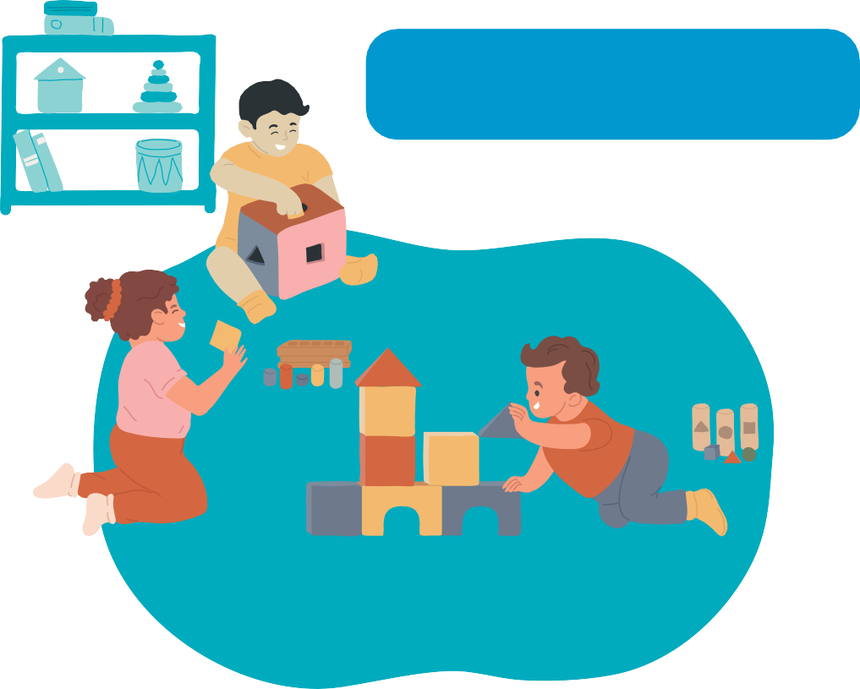
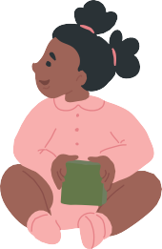
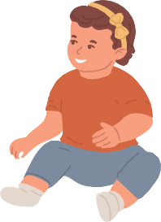
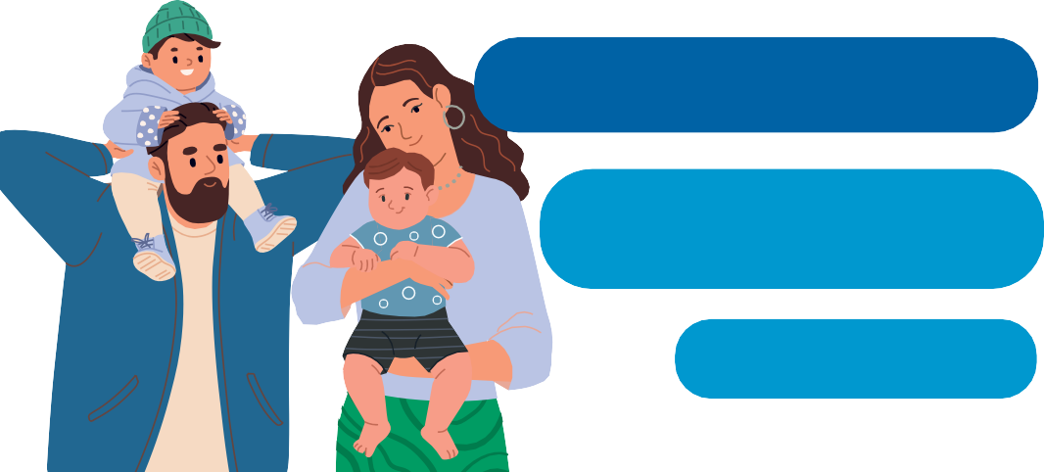



Care for your kids - use antibiotics wisely
4. Starting preschool? Get ready for more sniles.
In their first year of nursery school, children can spend much of their time with a runny nose, cough, or fever.
Caring for your child means making informed choices about their health. Antibiotics are essential medicines, but they are not always the answer to your child's illness. This brochure helps you understand the role of antibiotics and why using them wisely helps to protect your child and keep antibiotics working for the future.
Use antibiotics wisely so they will work when your children really need them.
This is normal and helps your child to build up the immunity they will need throughout their lives.
More infections does not mean more antibiotics.
1. Understanding childhood infections
Most childhood coughs and sniffs are caused by viruses. Antibiotics do not work against viruses.
Usually the best medicine is rest, time and plenty to drink. Antibiotics will not make viral infections go away faster.
Giving antibiotics “just in case” may do more harm than good.
Reassuring signs:
your child is alert and responsive,
they are drinking enough fluids,
their symptoms are stable or improving
they can play or engage in normal activities
Still coughing? Often nothing to worry about. Many children continue coughing for 2-3 weeks after a cold.
Your child needs to see a doctor
urgently if they show any of these signs:
they have breathing problems,
they are not drinking as much as usual or seem dehydrated,
they are unusually drowsy,
they appear confused,
you have di culty waking them,
their skin colour looks different,
their symptoms are getting much worse.
Talk to your doctor about:
what’s normal
warning signs
when to seek help.

Slide 2


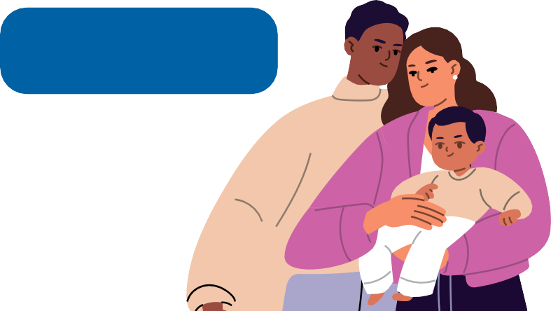


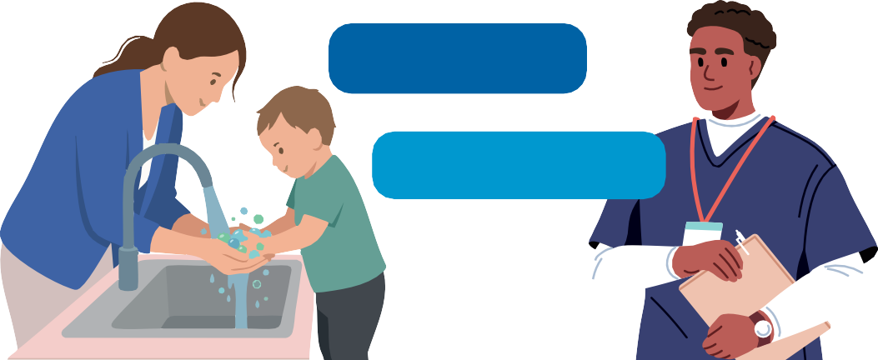
If your child has a bacterial infection, antibiotics could be crucial. And then it’s crucial that they work.
Your child’s body is home to billions of helpful bacteria.
Every unnecessary use increases the risk of bacteria becoming resistant to antibiotics.
These bacteria are good for their health and development. Using antibiotics unnecessarily can upset this natural balance.
Protect antibiotics so they can protect your children.
2. Antibiotics can cause side effects.
3. Prevent infections. Reduce the need for antibiotics.
Antibiotics should only be used:
when they are needed
as prescribed by your doctor, and
for the entire duration prescribed.
Vaccination protects children from many infections and can reduce the need for antibiotics.
The right antibiotic is one that is really needed.
Keep up to date with your child's vaccinations.
vaccination-info.eu
Antibiotics can have side effects. They can cause diarrhoea, nausea or skin rashes.
Clean hands help prevent infections from spreading.
They should therefore only be used when the benefits clearly outweigh the risks.
Teach children to wash their hands to protect them from getting sick.

