Slide 1

Care for your kids -
use antibiotics wisely
Understanding
childhood infections

Slide 2

Most childhood coughs and sniffs are caused by viruses.
Antibiotics do not work against viruses.
Usually the best medicine is rest, time and plenty to drink. Antibiotics will not make viral infections go away faster.
Giving antibiotics “just in case” may do more harm than good.

Slide 3

Still coughing?
Often nothing to worry about. Many children continue coughing for 2-3 weeks after a cold.
Talk to your doctor about:
what’s normal
warning signs
when to seek help.

Slide 4
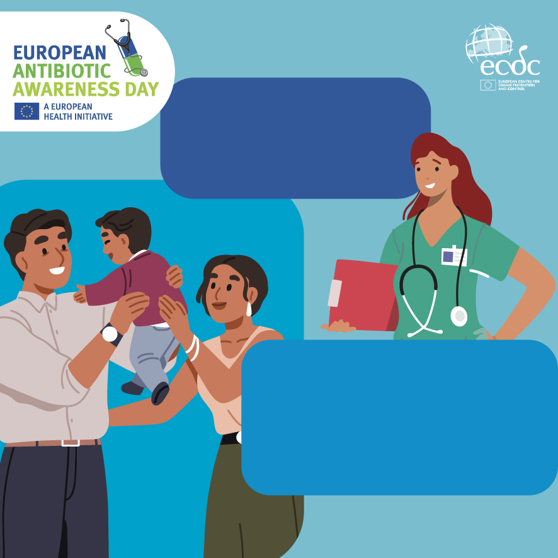
If your child has a bacterial infection, antibiotics could be crucial. And then it’s also crucial that they work.
Every unnecessary use increases the risk of bacteria becoming resistant to antibiotics.
Protect antibiotics so they can protect your children.

Slide 5

Care for your kids -
use antibiotics wisely
Antibiotics can cause
side effects.

Slide 6
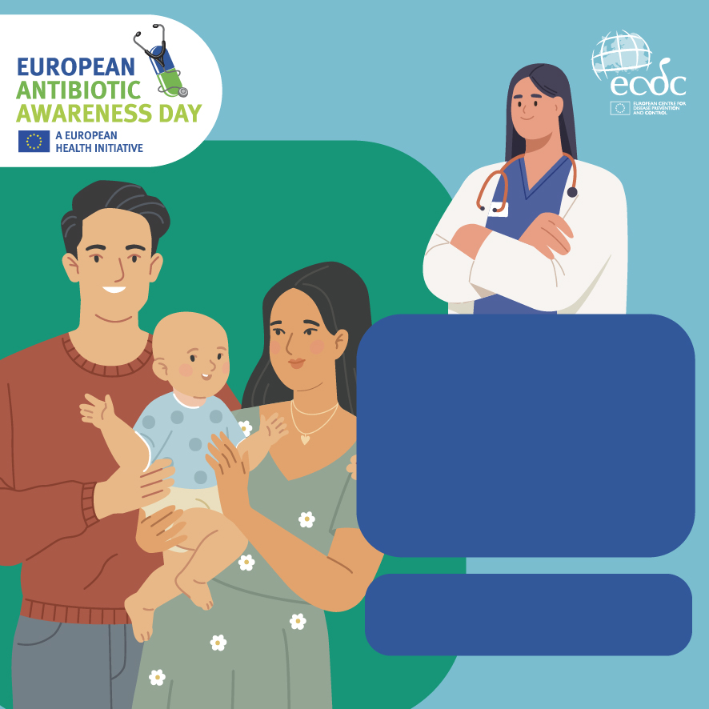
Antibiotics should only
be used:
when they are needed
as prescribed by your doctor, and
for the entire duration prescribed.
The right antibiotic is one that is really needed.

Slide 7

Antibiotics can have side effects. They can cause diarrhoea, nausea or skin rashes.
They should therefore only be used when the benefits clearly outweigh the risks.

Slide 8

Your child’s body is home to billions of helpful bacteria.
These bacteria are good for their health and development.
Using antibiotics unnecessarily can upset this natural balance.

Slide 9
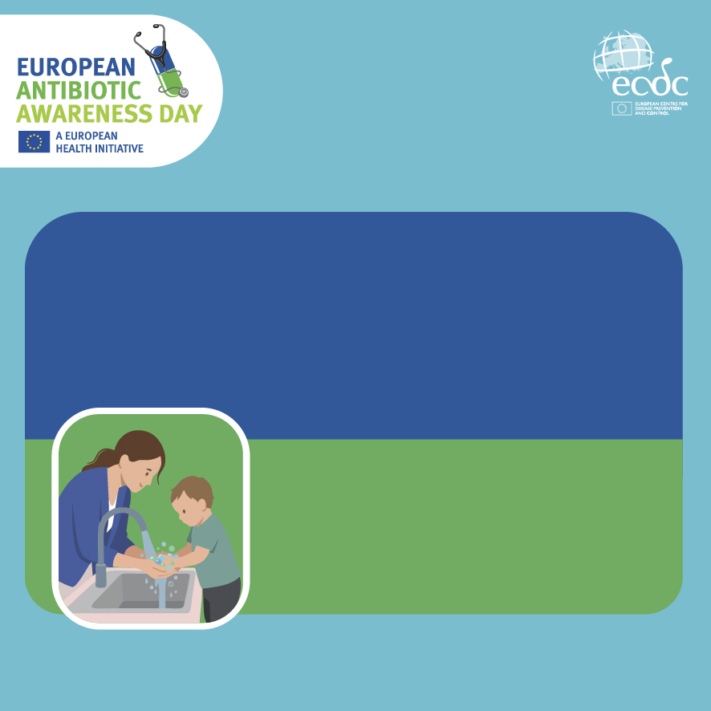
Care for your kids -
use antibiotics wisely
Prevent infections.
Reduce the need for
antibiotics.

Slide 10
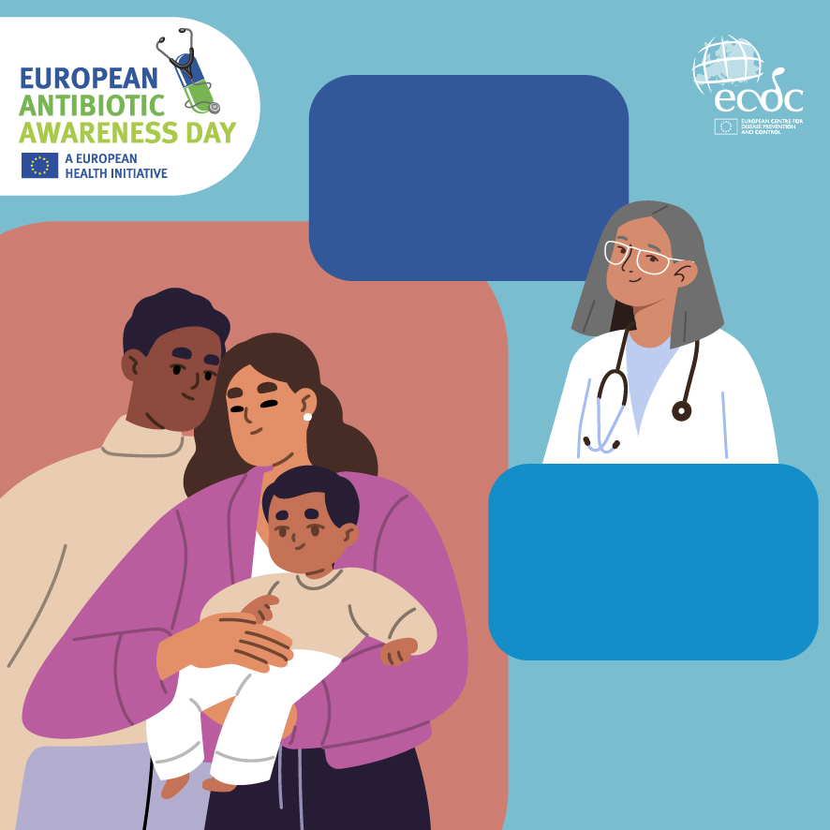
Vaccination protects children from many infections and can reduce the need for antibiotics.
Keep up to date with your child’s vaccinations.
vaccination-info.eu

Slide 11
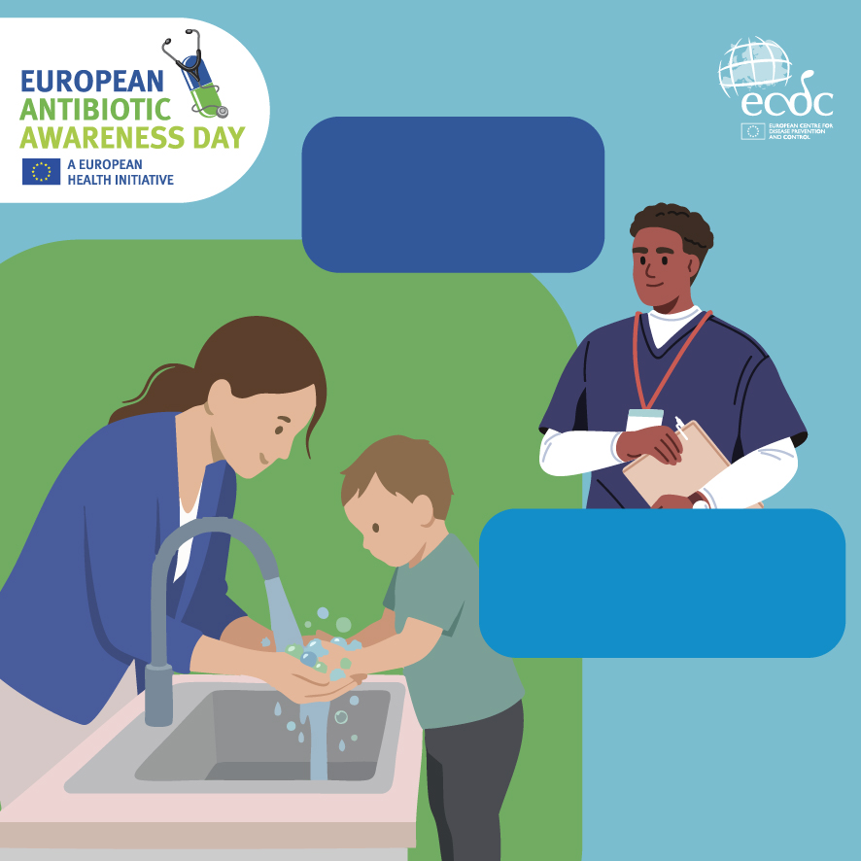
Clean hands help
prevent infections from spreading.
Teach children to wash their hands to protect them from getting sick.

Slide 12
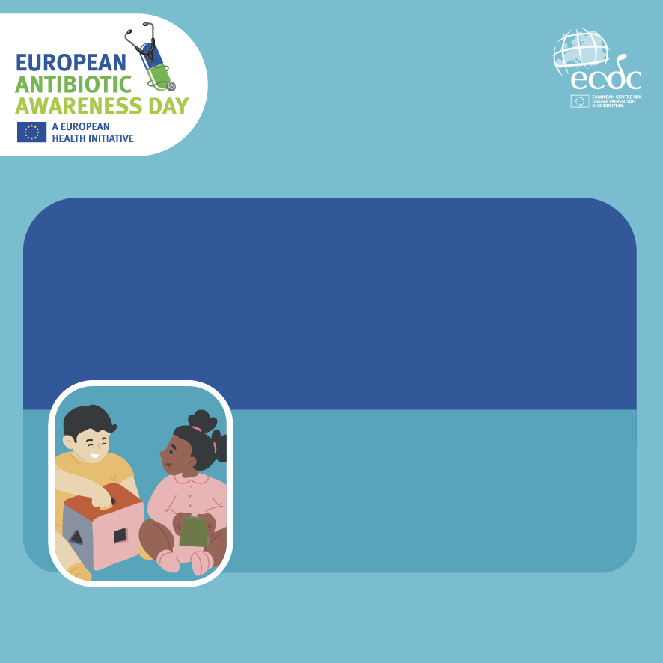
Care for your kids -
use antibiotics wisely
Starting preschool?
Get ready for more
sniffles.

Slide 13
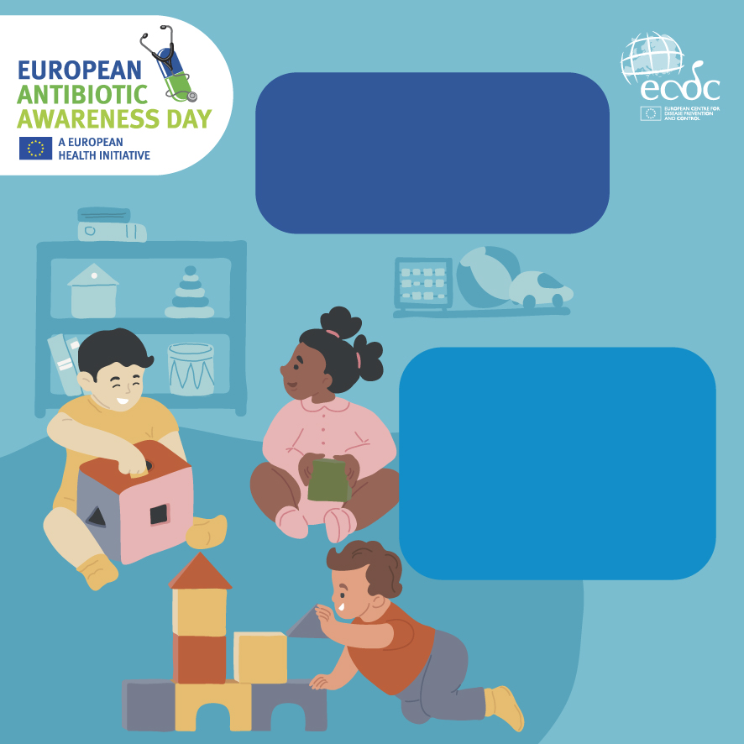
In their first year of nursery school, children can spend much of their time with a runny nose, cough, or fever.
This is normal and helps your child to build up the immunity they will need throughout their lives.
More infections does not mean more antibiotics.

